Slide 1
Use and Care of the Microscope
Dr.
Zainab A. Hasan
2017

Slide 2
Microscope is the device for magnifying objects that are too small to be seen with the naked eye. Magnification is the process of enlarging the size of an object , as an optical image

Slide 3
Microscopes are divided into two categories : 1- Electron microscopes 2- Light microscopes

Slide 4
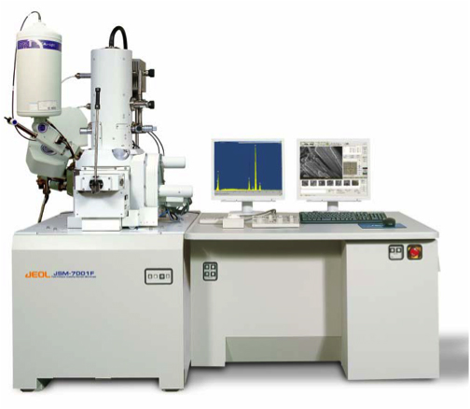
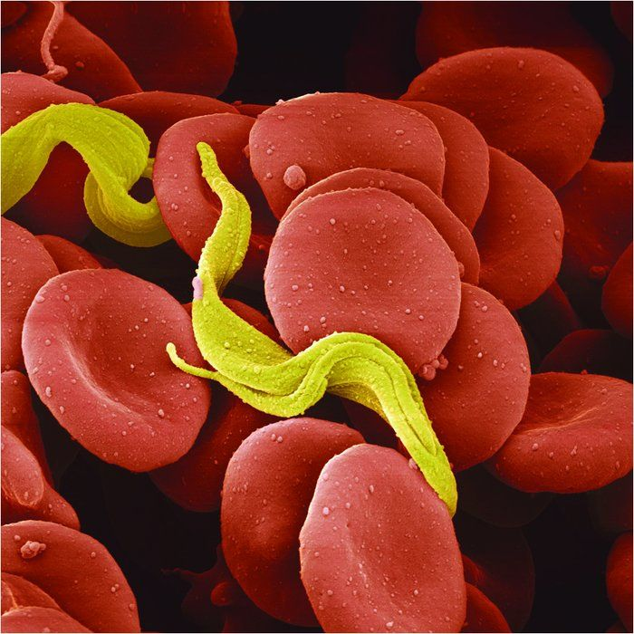
1- Electron microscopes : are subdivided into A- Scanning electron microscope (SEM) : In this microscope the electrons are used as the source of illumination instead of light . This microscope can have a magnification up to 100,000 X and it used to provide a three –dimensional view of cells.

Slide 5
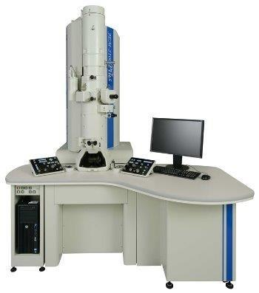
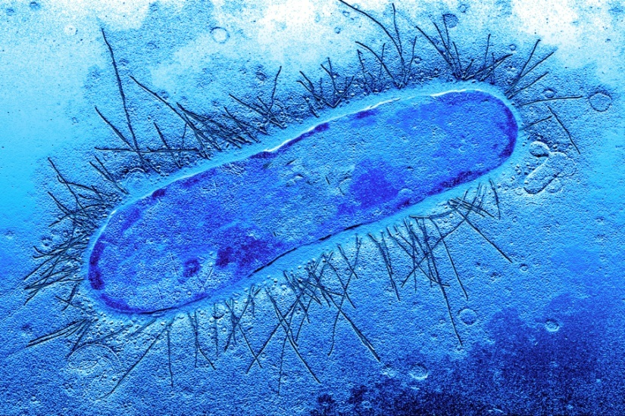
B- Transmission electron microscope (TEM): Also the electrons are used as the source of illumination and have a magnification of 100,000 X or greater , but it used to view very thin sections of cells to reveal their internal structure , and also used to study viral-infected cells .

Slide 6
2- Light microscopes : are subdivided into a- Fluorescent microscope : b- Bright –field microscope :

Slide 7
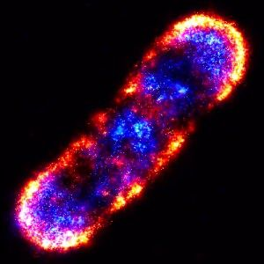
a- Fluorescent microscope : The magnification of this microscope is 2600 X and its focuses ultraviolet light on a specimen , causing of some molecules in the specimen to be fluoresce .

Slide 8
b- Bright –field microscope : This microscope is used to study the size , shape ,and arrangement of the microbial cells , but it provides little information about the internal cell structure . There is two types of this microscope : Simple microscope : It has a single lens magnifier. Compound microscope : It employs two or more lenses called ocular and objective lenses - Ocular lenses (10X) Monocular microscope ( Has one ocular lens) binocular microscope ( Has two ocular lens )

Slide 9
- Objective lenses Scanning lens (4X) Low power lens (10X) High power lens (40X) Oil immersion lens(100X)

Slide 10
The magnification of the microscope depends on the type of objective lens used with the ocular lens . So , the total magnification is calculated by multiplying the objective lens by ocular lens.
Total magnification |  | Ocular lens | Objective lens
40x | = | 10x | 4x | Scanning lens
100x | = | 10x | 10x | Low power lens
400x | = | 10x | 40x | High power lens
1000x | = | 10x | 100x | Oil immersion lens

Slide 11
The most important lens in microbiology is the oil immersion lens because it is provide the highest magnification and must be used with immersion oil . Immersion oil has the same refractive index as glass , so the oil becomes part from the optics of the microscope . By placing immersion oil between the glass slide and the oil immersion lens (100x) , the light rays at the highest magnification can be retained. Without placing the oil ,the light rays are refracted as they enter the air between the slide and lens , so ,the objective lens would have to be increased in diameter in order to capture them . Thus using oil has the same effect as increasing the objective diameter , therefore improving the resolving power of the lens.

Slide 13
Microscope care Microscope is a very important tool in microbiology and it must be used carefully and correctly . Follow these guidelines every time you use a microscope : 1- carry the microscope with both hands , one hand beneath the base and the other on the arm . Never slide a microscope a cross a bench surface . 2- Clean the microscope both before and after use . Use only lens paper and lens cleaner . 3-Only use oil when using the 100X oil immersion lens . Do not get oil on the other objective lenses. 4-Do not wrap the cord around the microscope . Instead , fold the cord and place it between the arm and the stage or beneath the stage. 5- Observe the slide with both eyes open , to avoid eyestrain. 6- Always focus with low power first . 7- Keep the stage clean and free of oil . 8- wipe oil off the oil immersion lens before putting your microscope away . Do not touch the lenses with your hands . 9- Clean the ocular lens carefully with lens paper if dust is present . 10- Replace the dust cover before putting the microscope away . 11- Make sure that the specimen is on the top –side of the slide when using the oil immersion lens . 12- Increase the amount of light when using the oil immersion lens .

